Slide 1
Component-Based Software Engineering (CBSE) & Computer-Aided Software Engineering (CASE)
Chapter 12

Slide 2
Lesson Objectives
Explain the 4 main activities in CBSE process
Evaluate the use of CBSE approach – Benefits and Obstacles

Slide 3
Introduction
Design & Construction →
Reusable software components
E.g. reuse the programs / screens from previous projects/ Assignments
Notes:
CBSE is an approach to software development that relies on reuse
CBSE emerged from the failure of object-oriented development to support reuse effectively
Objects (classes) are too specific and too detailed to support design for reuse work
Components are more abstract than classes and can be considered to be stand-alone service providers

Slide 4
Introduction
Component-based software engineering (CBSE) is a process that emphasizes the design and construction of computer-based systems using reusable software “components”.
E.g.:
Reuse the programs / screens from
previous projects/ Assignments

Slide 5
Introduction
Establish SRS,
Architectural design
Examine any components
can be reused?
Yes
No
CBSE
Use conventional or O-O SE to develop new components
- Component Qualification
- Component Adaptation
- Component Composition
- Component Update

Slide 6
4 Activities in CBSE

Slide 7
CBSE Activities
Component Qualification
Component Adaptation
Component Composition
Component Update

Slide 8

CBSE Activities - Component Qualification
Use a process of discovery & analysis to qualify each component’s fit in architecture & requirements.

Slide 9
CBSE Activities - Component Qualification
Function
Run-time requirements
Service requirements
Exception Handling
Factors to consider a component
Security Features
Notes:
Use a process of discovery and analysis to qualify each component’s fit in architecture and requirements.
Ensures that a candidate component will perform the function required
Before a component can be used, factors need to consider includes: the run-time requirements, services requirements, exception handling, security features etc

Slide 10

CBSE Activities - Component Adaptation
Change to meet architectural need
Remove architectural mismatches
Conflict
Notes:
Components adapted to meet the needs of architecture or to remove architectural mismatches, and be replaced by more suitable components
In reality, qualified component for use may exhibit conflict in one or more of the areas.

Slide 11
CBSE Activities - Component Adaptation
White box wrapping:
Code-level modification
Not for COTS components
Adaptation Technique:
Component Wrapping
Notes:
Commercial off-the-shelf (CTOS)

Slide 12
CBSE Activities - Component Adaptation
Gray box wrapping:
Component library
component extension language
API
Remove/Mask Conflicts
Adaptation Technique:
Component Wrapping
Notes:
Application programming interface (API)

Slide 13
CBSE Activities - Component Adaptation
Black box wrapping:
Pre-processing
Post-processing
Remove/Mask Conflicts
Adaptation Technique:
Component Wrapping

Slide 14
CBSE Activities – Component Adaptation
To mitigate against these conflicts, an adaptation technique called component wrapping is often used.
white-box wrapping
examines the internal processing details of the component and makes code-level modifications to remove any conflict.
Not for the case when COTS components are used.
gray-box wrapping
applied when the component library provides a component extension language or API that enables conflicts to be removed or masked.
black-box wrapping
requires the introduction of pre- and post processing at the component interface to remove or mask conflicts.

Slide 15

CBSE Activities - Component Composition
Assembles all the components together
An infrastructure must be established to bind the components into an operational system
Notes:
Assembles qualified, adapted, and engineered components to populate the architecture established for an application.
An infrastructure must be established to bind the components into an operational system.

Slide 16

CBSE Activities - Component Update
Requirement changed
New release
Notes:
When requirements for the system change
Update the components if requirements change / new release available

Slide 17
Benefits & Obstacles of CBSE

Slide 18

Evaluation – Benefits of CBSE
Improved Quality
Notes:
Improve Quality
provides a high-performance & more reliable end product as components have been used many times, each time getting more refined and reliable as they are reused and re-tested.
Increase Productivity
reduces the time required for code development, documentation, system modeling, and planning
Save Cost
reduces development cost from scratch & testing overhead

Slide 19
Evaluation – Benefits of CBSE
Increase Productivity
Notes:
Improve Quality
provides a high-performance & more reliable end product as components have been used many times, each time getting more refined and reliable as they are reused and re-tested.
Increase Productivity
reduces the time required for code development, documentation, system modeling, and planning
Save Cost
reduces development cost from scratch & testing overhead

Slide 20
Evaluation – Benefits of CBSE
Save Cost
Notes:
Improve Quality
provides a high-performance & more reliable end product as components have been used many times, each time getting more refined and reliable as they are reused and re-tested.
Increase Productivity
reduces the time required for code development, documentation, system modeling, and planning
Save Cost
reduces development cost from scratch & testing overhead

Slide 21

Evaluation – Obstacles of CBSE
Training
Notes:
Little training is available to help s/w engineers & mgrs to understand & apply resue
Many s/w practitioners continue to believe that reuse is “more trouble than it’s worth”.
Few s/w companies to provide incentive to reusable components program
Many companies continue to encourage of s/w development methodologies which do not facilitate reuse.

Slide 22
Evaluation – Obstacles of CBSE
Reuse – more trouble than it’s worth
Notes:
Little training is available to help s/w engineers & mgrs to understand & apply resue
Many s/w practitioners continue to believe that reuse is “more trouble than it’s worth”.
Few s/w companies to provide incentive to reusable components program
Many companies continue to encourage of s/w development methodologies which do not facilitate reuse.

Slide 23
Evaluation – Obstacles of CBSE
No incentive
Notes:
Little training is available to help s/w engineers & mgrs to understand & apply resue
Many s/w practitioners continue to believe that reuse is “more trouble than it’s worth”.
Few s/w companies to provide incentive to reusable components program
Many companies continue to encourage of s/w development methodologies which do not facilitate reuse.

Slide 24
Evaluation – Obstacles of CBSE
Software development methodologies which do not facilitate reuse
Notes:
Little training is available to help s/w engineers & mgrs to understand & apply resue
Many s/w practitioners continue to believe that reuse is “more trouble than it’s worth”.
Few s/w companies to provide incentive to reusable components program
Many companies continue to encourage of s/w development methodologies which do not facilitate reuse.

Slide 25
Revision
CBSE 4 activities
CBSE Benefits
CBSE Obstacles

Slide 26
Computer-Aided Software Engineering (CASE) Technology
3 Level of CASE

Slide 27

CASE Technology
1. Production Process Support Technology
Process activities
Specification
Design
Testing
3 Levels of CASE
Notes:
Three different levels of CASE technology can be identified: -
Production-process support technology – support for process activities such as specification, design, testing and etc.
Process management technology – support modeling and process management.
Meta-CASE technology – generators which are used to create production-process and process management support tools.

Slide 28
CASE Technology
2. Process Management Tech
Modeling and Process Management
Risk Mgmt
Requirement Mgmt
Change Mgmt
HR Mgmt
Time Mgmt
Cost Mgmt
Quality Mgmt
Configuration Mgmt
3 Levels of CASE
Notes:
Three different levels of CASE technology can be identified: -
Production-process support technology – support for process activities such as specification, design, testing and etc.
Process management technology – support modeling and process management.
Meta-CASE technology – generators which are used to create production-process and process management support tools.

Slide 29
CASE Technology
3. Meta-CASE Technology
Generator to create technology 1 & 2
3 Levels of CASE
Production process support Tech
Process Management Tech
Notes:
Three different levels of CASE technology can be identified: -
Production-process support technology – support for process activities such as specification, design, testing and etc.
Process management technology – support modeling and process management.
Meta-CASE technology – generators which are used to create production-process and process management support tools.

Slide 30
Functional Classification of CASE

Slide 31
Functional Classification of CASE
Tools are specified according to the functions they support

Slide 32

Functional Classification of CASE
1. Business Process Engineering Tools
Flowchart
Data Flow between dept.

Slide 33
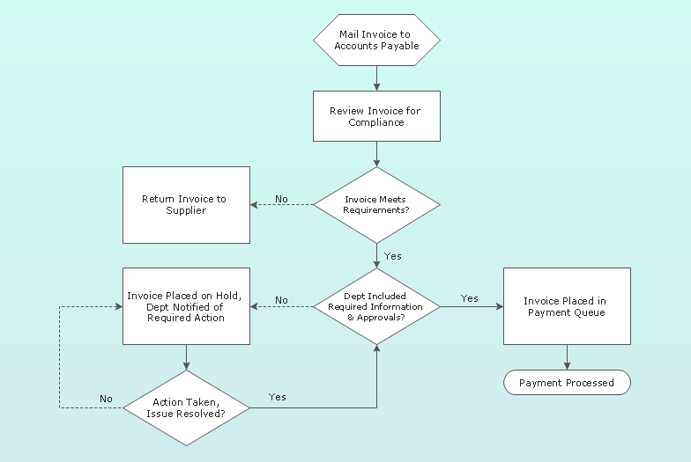
Functional Classification of CASE
Functionality-tools are specified according to the functions they support:
Business process engineering tools – trace and track data flows between different original departments. Output of this CASE tool can be a flowchart.

Slide 34

Functional Classification of CASE
2. Process Modeling and Management Tools
e.g. Visio

Slide 35
Functional Classification of CASE
3. Data Modeling Tools
e.g. DBMS

Slide 36
Functional Classification of CASE
4. Project Planning/Management Tools
e.g. Excel
Estimates Cost & Time
JIRA

Slide 37
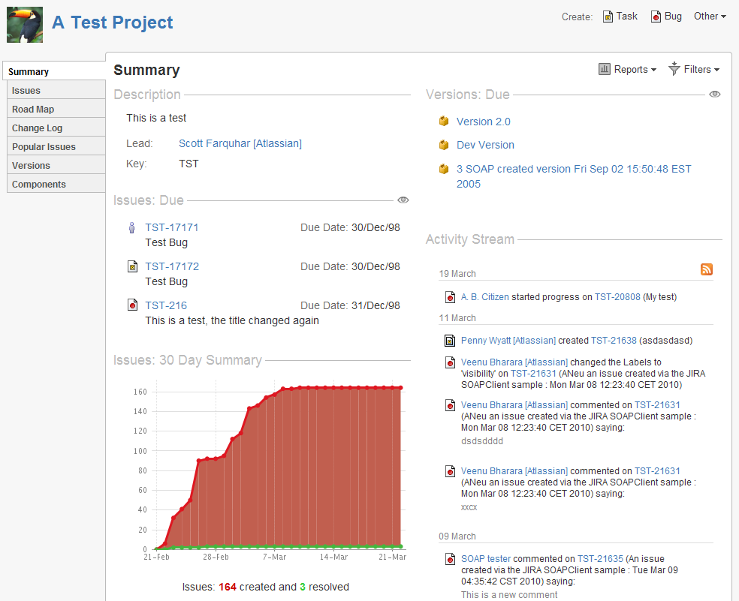
Functional Classification of CASE
4. Project Planning/Management Tools
cost /cost and time estimation, e.g. Excel Spreadsheet
Atlassian JIRA project management tool

Slide 38
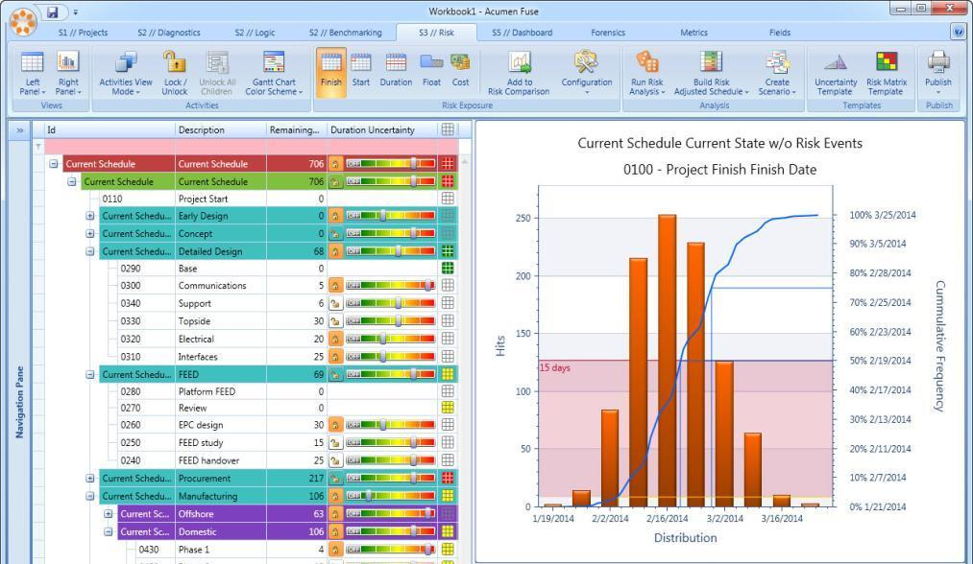
Functional Classification of CASE
5. Risk Analysis Tools
Manage Project Risk
Acumen Risk is a Monte Carlo risk analysis tool combining true cost and schedule risk analysis against a native project plan together with identified risk events from a project risk register.

Slide 39
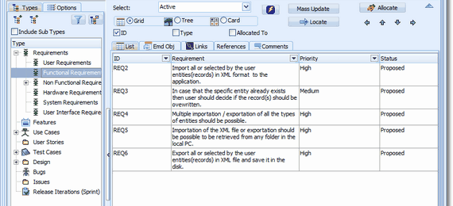
Functional Classification of CASE
6. Requirement Tracing Tools
Ensure functions delivered completely

Slide 40
Functional Classification of CASE
7. Metrics & Management Tools
Software Quality Management
COQUALMO is a tool used to predict the number of residual defects in a software product.

Slide 41
Functional Classification of CASE
9. Prototyping Tools
- user interface generators, e.g. VB
UI generator
e.g. VB

Slide 42
Functional Classification of CASE
8. Editing Tools
- text & diagram editors
Text & Diagrams

Slide 43
Functional Classification of CASE
10. Method Support Tools
Design & Code
Data dictionaries
e.g. IBM RSA

Slide 44
Functional Classification of CASE
11. Language Processing Tools
Compilers
Interpreter

Slide 45
Functional Classification of CASE
12. Debugging Tools
Test & debug program

Slide 46
Functional Classification of CASE
13. Testing Tools
– test data generators, test coverage analysis and reporting
Test coverage analysis
Test data generator
Test report

Slide 47
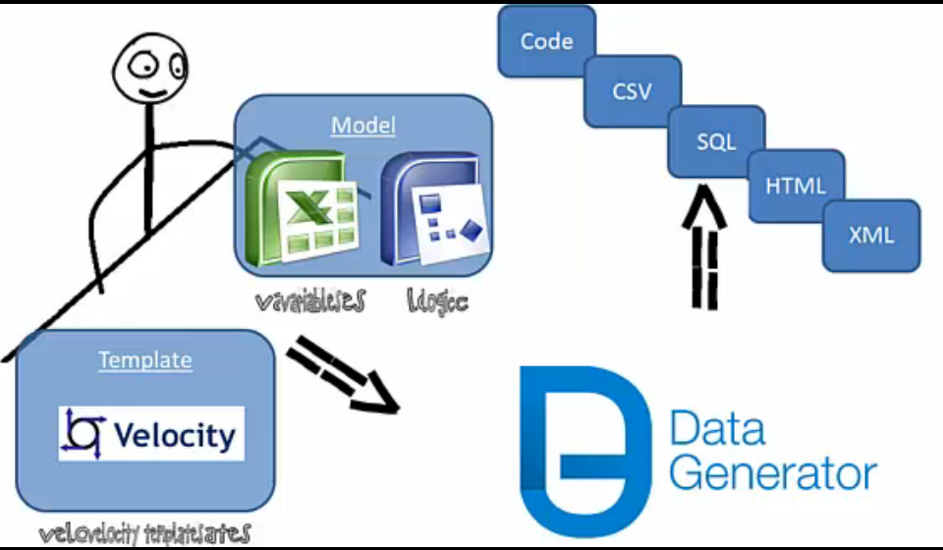
Functional Classification of CASE
13. Testing Tools
– test data generators, test coverage analysis and reporting
Notes:
Data Generator is a tool to automatically generate test data from model and template. Even if requirements are changing, test data can be changed automatically.

Slide 48
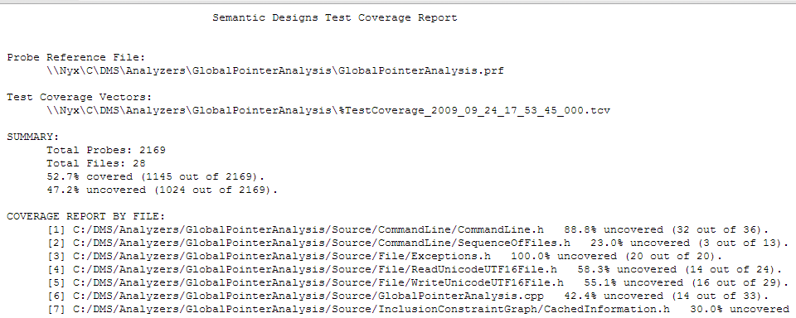
Functional Classification of CASE
13. Testing Tools
– test data generators, test coverage analysis and reporting
Notes:
Data Generator is a tool to automatically generate test data from model and template. Even if requirements are changing, test data can be changed automatically.

Slide 49
Functional Classification of CASE
14. Documentation Tools
– page layout programs, image editor
Image editor
Page Layout Program

Slide 50
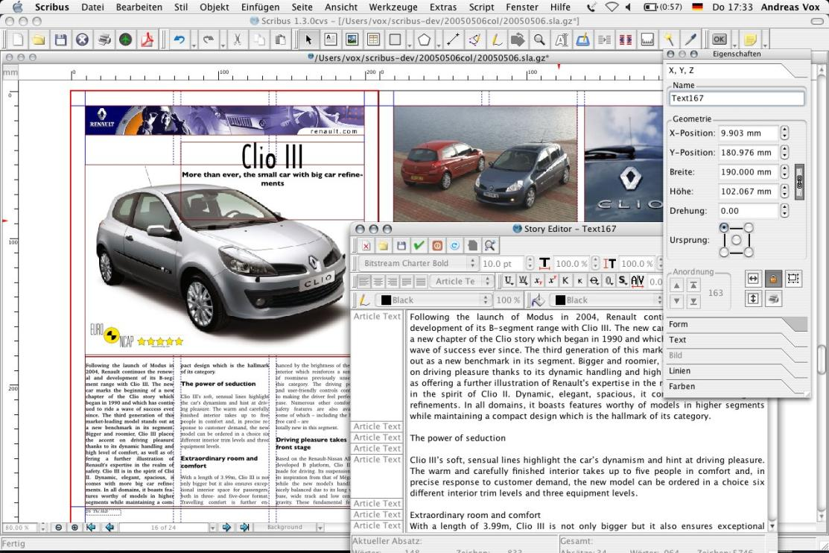
Functional Classification of CASE
14. Documentation Tools
Scribus – page layout program

Slide 51
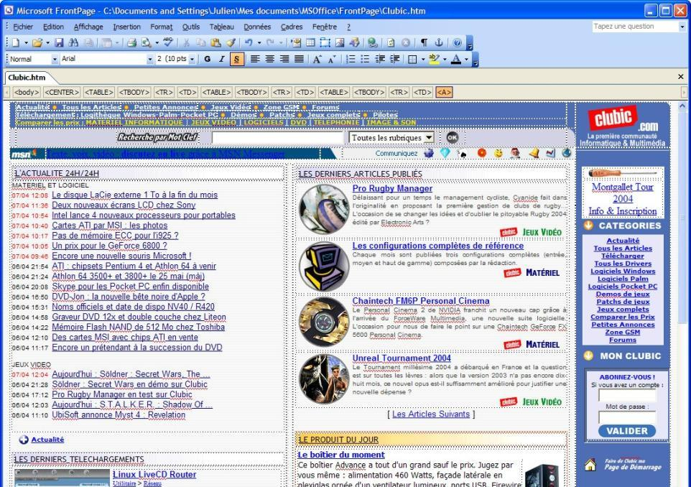
Functional Classification of CASE
15. Web Development Tools
e.g. FrontPage

Slide 52
Functional Classification of CASE
16. Software Configuration Management Tools
e.g. SQL Server DB Change Mgmt
Version & Change Mgmt

Slide 53
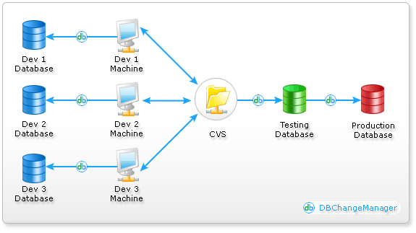
Functional Classification of CASE
16. Software Configuration Management Tools
SQL Server Database Change Management:

Slide 54
Functional Classification of CASE
16. Software Configuration Management tools – version and change management systems, e.g. SQL Server Database Change Management
SQL Server Database Change Management:
Database Change Management forms an important part of an application development process. Database Change Management refers to the process of maintaining the Integrity and proper functioning of a database schema throughout a collaborative development cycle.
Collaborative development environments typically involve multiple database developers working in various sections of the same database schema in parallel, introducing changes that are invisible to one another. Key challenge in such an environment is to ensure that the changes done in parallel does not affect the system as a whole and incremental changes done to the system always takes into account all the recent changes that have been effected thereby maintaining integrity.

Slide 55
Other Classification of CASE

Slide 56


Other Classification of CASE
Tools – support individual tasks (stand alone tool) like compiler, word processor and etc
Breadth of Support

Slide 57
Other Classification of CASE
Workbenches
→ support process phases or activities like specification, analysis, design and etc. Normally, include a few tools
Breadth of Support

Slide 58
Other Classification of CASE
Environment
→ support all or at least a substantial part of s/w process. Normally, include several workbenches that integrated together.
Breadth of Support

Slide 59
CASE Life Cycle

Slide 60
CASE Life Cycle
Procurement
Tailoring
Introduction
Obsolescence
Evolution
Operation

Slide 61
CASE Life Cycle
The stages of the CASE life cycle are:-
Procurement – choose an appropriate CASE system
Tailoring – adapts a CASE system to a particular set of organization or project requirements
Introduction – introduces the CASE system into a working context

Slide 62
CASE Life Cycle
The stages of the CASE life cycle are:-
Operation – the CASE system is in everyday use for software development
Evolution – modifying the h/w or s/w to adapt to new requirements
Obsolescence – the CASE is taken out of use. Need to ensure that the s/w developed using the system can still be supported by the org.

Slide 63
Issues in CASE Life Cycle

Slide 64
Issues in CASE Life Cycle
Procurement
Tailoring
Introduction
Obsolescence
Evolution
Operation

Slide 65


Issues in CASE Life Cycle
Procurement
1. Organization Standards & Methods
Visio supports SSADM convention?
Notes:
The factor which must be taken into account when procuring a company-wide CASE system are: -
Existing company standards and methods – Visio supports SSADM convention?
Existing computers and future computer procurement
– memory, CPU, OS
The class of applications to be developed – choose a CASE that provides facilities for developing the type of applications required by an org.
Security – provide any security features?
Cost – expensive? Within budget?

Slide 66
Issues in CASE Life Cycle
Procurement
2. Existing computers & Future computer procurement
Memory? CPU? OS?
Notes:
The factor which must be taken into account when procuring a company-wide CASE system are: -
Existing company standards and methods – Visio supports SSADM convention?
Existing computers and future computer procurement
– memory, CPU, OS
The class of applications to be developed – choose a CASE that provides facilities for developing the type of applications required by an org.
Security – provide any security features?
Cost – expensive? Within budget?

Slide 67

Issues in CASE Life Cycle
Procurement
3. The type of application to be developed
choose a CASE that provides facilities for developing the type of applications required by an org.
Notes:
The factor which must be taken into account when procuring a company-wide CASE system are: -
Existing company standards and methods – Visio supports SSADM convention?
Existing computers and future computer procurement
– memory, CPU, OS
The class of applications to be developed – choose a CASE that provides facilities for developing the type of applications required by an org.
Security – provide any security features?
Cost – expensive? Within budget?

Slide 68
Issues in CASE Life Cycle
Procurement
4. Security
Provide any security feature?
Notes:
The factor which must be taken into account when procuring a company-wide CASE system are: -
Existing company standards and methods – Visio supports SSADM convention?
Existing computers and future computer procurement
– memory, CPU, OS
The class of applications to be developed – choose a CASE that provides facilities for developing the type of applications required by an org.
Security – provide any security features?
Cost – expensive? Within budget?

Slide 69
Issues in CASE Life Cycle
Procurement
5. Cost
Expensive?
Within budget?
Notes:
The factor which must be taken into account when procuring a company-wide CASE system are: -
Existing company standards and methods – Visio supports SSADM convention?
Existing computers and future computer procurement
– memory, CPU, OS
The class of applications to be developed – choose a CASE that provides facilities for developing the type of applications required by an org.
Security – provide any security features?
Cost – expensive? Within budget?

Slide 70
Issues in CASE Life Cycle
Tailoring
1. Installation & Testing
Notes:
The activities required to customize a CASE system for a particular organization and application domain include:-
Installation – installed & tested on org’s h/w
Process model definition – allows CASE mgr to see where the tool can be applied & what interfaces to other tools may need to be constructed
Tool integration – develop interface modules to integrate different tools
Documentation

Slide 71
Issues in CASE Life Cycle
Tailoring
2. Process Model Definition
Where to apply
Interface with other tools
Notes:
The activities required to customize a CASE system for a particular organization and application domain include:-
Installation – installed & tested on org’s h/w
Process model definition – allows CASE mgr to see where the tool can be applied & what interfaces to other tools may need to be constructed
Tool integration – develop interface modules to integrate different tools
Documentation

Slide 72
Issues in CASE Life Cycle
Tailoring
3. Tool Integration
develop interface modules to integrate different tools
Notes:
The activities required to customize a CASE system for a particular organization and application domain include:-
Installation – installed & tested on org’s h/w
Process model definition – allows CASE mgr to see where the tool can be applied & what interfaces to other tools may need to be constructed
Tool integration – develop interface modules to integrate different tools
Documentation

Slide 73
Issues in CASE Life Cycle
Tailoring
4. Documentation
develop interface modules to integrate different tools
How? What?
Where?
Who maintain?
Notes:
The activities required to customize a CASE system for a particular organization and application domain include:-
Installation – installed & tested on org’s h/w
Process model definition – allows CASE mgr to see where the tool can be applied & what interfaces to other tools may need to be constructed
Tool integration – develop interface modules to integrate different tools
Documentation

Slide 74
Issues in CASE Life Cycle
1. User Resistance
Introduction
2. Lack of Training
3. Management Resistance
Operation

Slide 75
Exercise
A commercial off-the-shelf program ZeeB is purchased by organization BIZ. The program has been examined and qualified to be used in the organization especially due to its comprehensive and free API library. However, some components in ZeeB need to be changed due to integration conflict with other organization’s existing programs. Suggest an adaptation technique (component wrapping) that can be used in this scenario.

